Slide 1
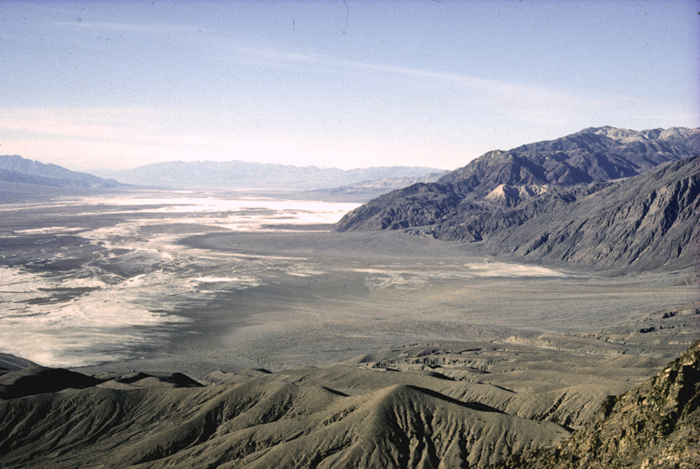
Dante’s View
Notes:
Perhaps the best viewpoint in the park is Dante's View. From there looking northwest the steep fault-bounded east side of Death Valley is clearly seen.

Slide 2
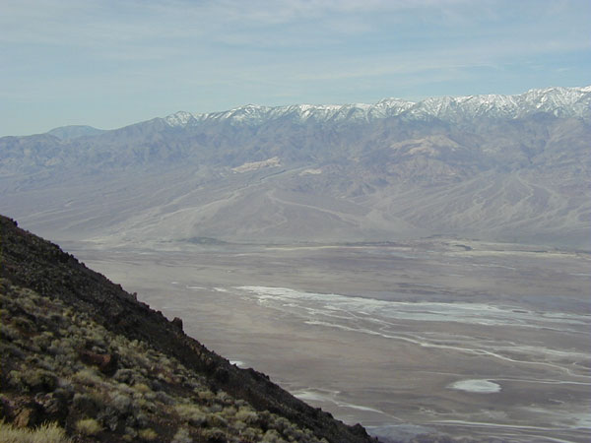
Notes:
Looking south and west, the alluvial fans of the Panamint Mountains are clearly visible across the valley. Notice the steep surface along the front of the mountain in the lower left foreground of this photo — this is the fault surface bounding one of the “turtlebacks” which so fascinate geologists. We’ll look at them in more detail soon.

Slide 3
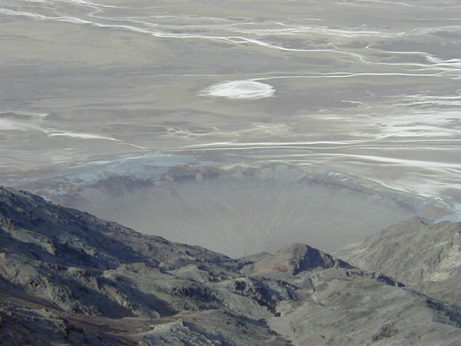
Notes:
Where steep, normal-faulted slopes transition to flat valley floor, sediments deposit rapidly as alluvial fans. Perhaps the most famous east-side alluvial fan is the Badwater fan, which forms from debris shed from the Black Mountains and extends into the Badwater saltpan. This photo looks down the fault bounding the Black Mountain turtleback onto the Badwater fan.

Slide 4
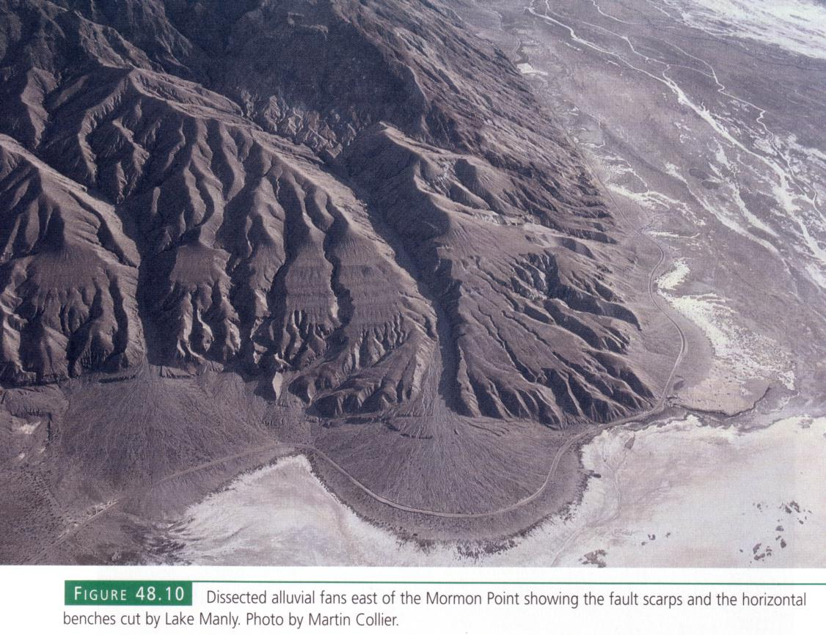
Notes:
Alluvial fans abound on the east side.

Slide 5
Notes:
Note the fault scarps which cut the fans and show that normal faulting is still very much active in the park.

Slide 6
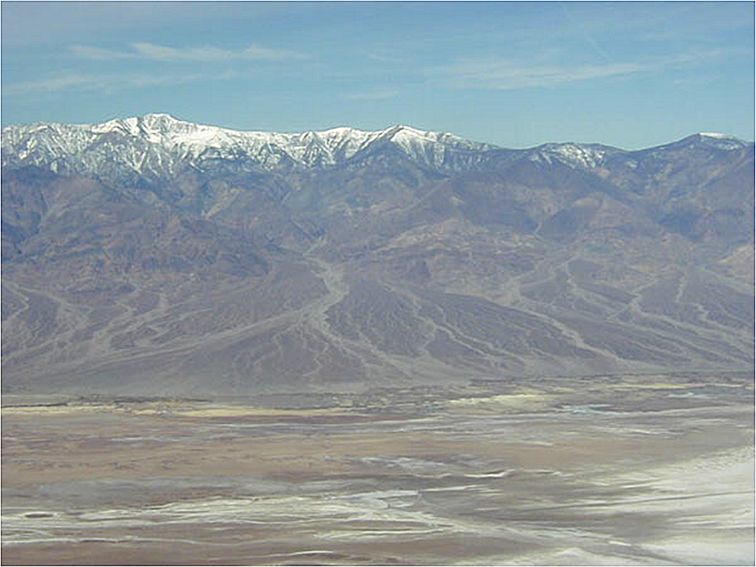
Notes:
Looking west across Death Valley, the high peak is Telescope Peak in the Panamint Range. Notice the large fans coalescing along the base of the range. The darker areas on the fans are less active than the lighter areas.

Slide 7
Notes:
When multiple fans coalesce to form a continuous sloping surface at the base of a range…

Slide 8
Bajada
Notes:
… the combined landform is called a bajada.

Slide 9
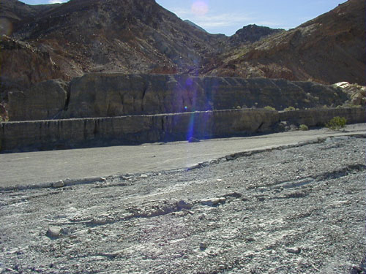
Notes:
Deposition on alluvial fans and bajadas is generally via mud and debris flows whose viscosity is similar to wet concrete.

Slide 10
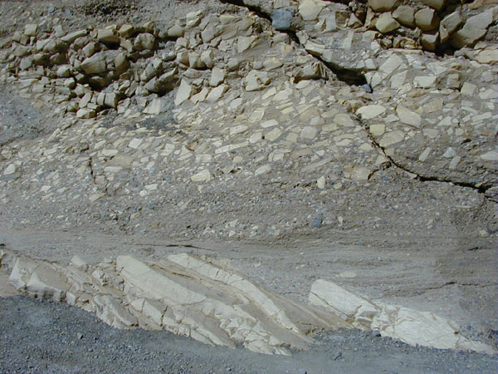
Notes:
Mosaic canyon gets its name from the lithified debris-flow deposits which overlie the Noonday Dolomite. The contact between the tilted older rocks and the flat-lying younger rocks represents an angular unconformity. The rock fragments (clasts) are matrix supported indicating deposition via viscous mudflow.

Slide 11
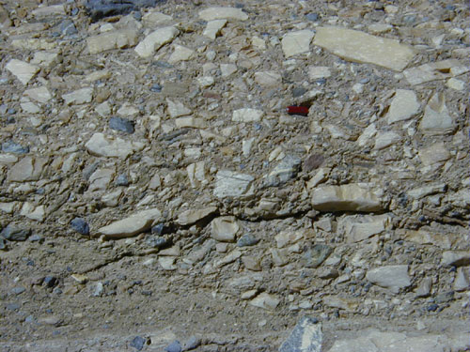
Notes:
In this close-up of the debris-flow, note the angularity of the rock fragments embedded in the finer matrix; the angular shape of the clasts suggests that they did not bang against one another during transport, but were instead buoyed up in the flow by its high density and that impacts were cushioned by its high viscosity.

Slide 12
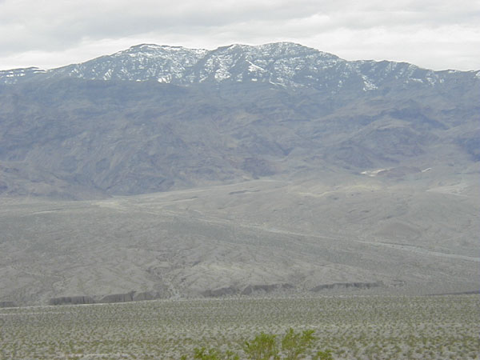
Notes:
As you move closer to the fans along the Panamint front, you'll notice a prominent ridge along the lower edge of the fans. This ridge is a modern fault scarp, which formed because Death Valley is still geologically active today.

Slide 13
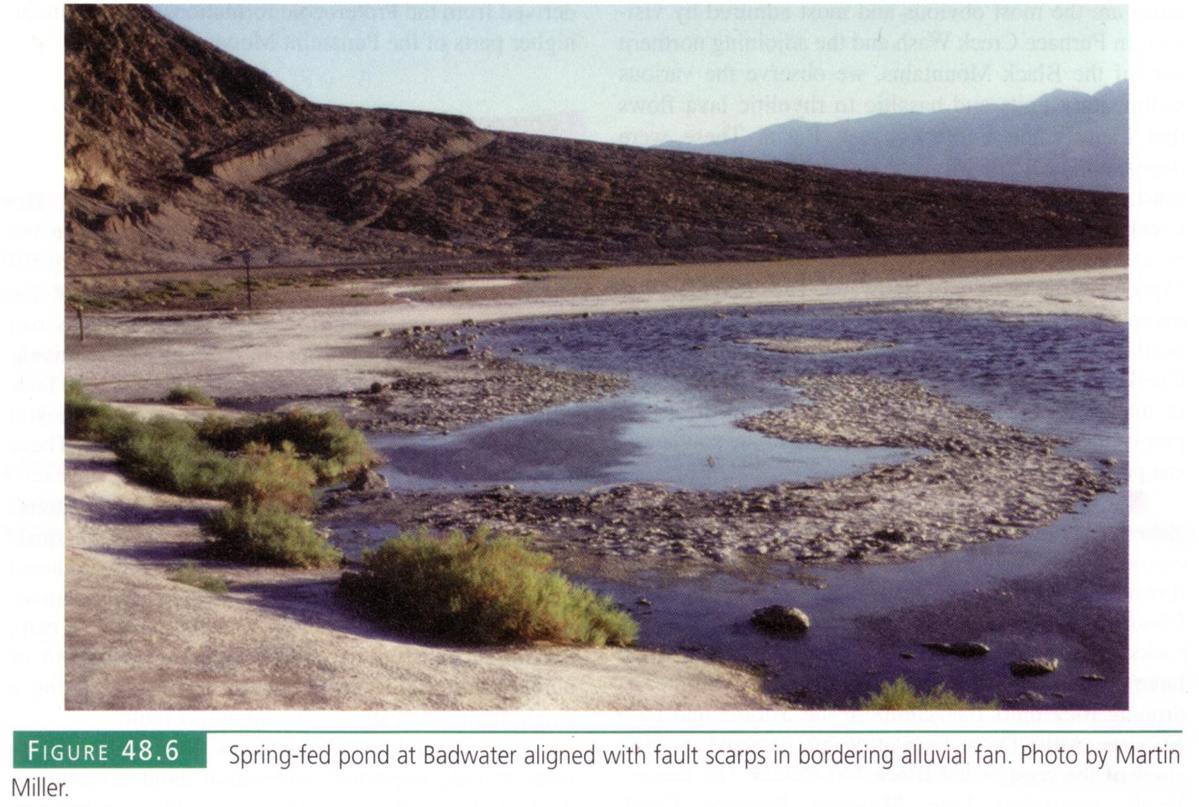
Notes:
Similar fault scarps are also seen across the Badwater fan at the base of the Black Mountains.

Slide 14
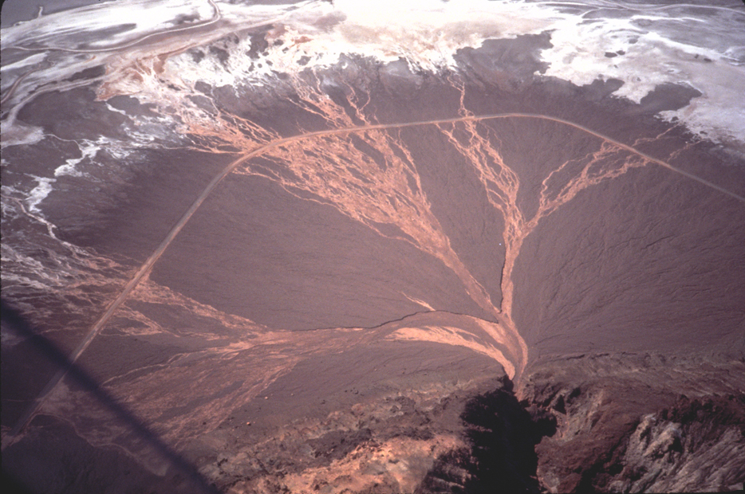
Notes:
This picture does a good job of showing why alluvial fans become fan shaped. When deposition occurs, that portion of the fan becomes a little higher, so the next time a mudflow occurs, gravity will pull it towards a lower part of the fan. Through time, deposition will therefore constantly shift position across the fan. Note the salt deposits at the base of the fan.

Slide 15
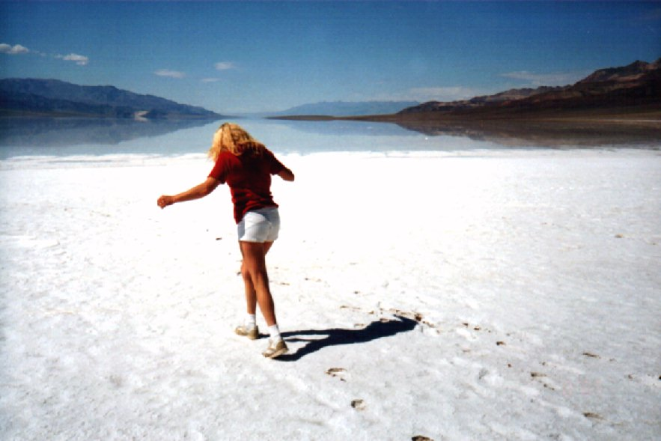
Notes:
During wet years large portions of the valley will be flooded. Here we see my wife cautiously crunching across the Badwater salt crust toward the large salt lake that formed after the El Nino winter of 97-98.

Slide 16
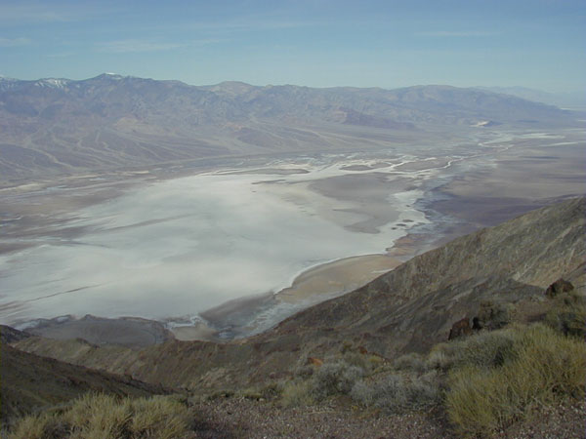
Notes:
Looking north and west across Death Valley from Dante’s View, the Badwater saltpan is clearly visible. Gravity-driven normal faulting has left vast areas of Death Valley below sea level, so runoff from the mountains is trapped and the dissolved salts inevitably precipitate upon evaporation. The lowest point in North America lies towards the center of the saltpan, but because it is flooded in wet years …

Slide 17
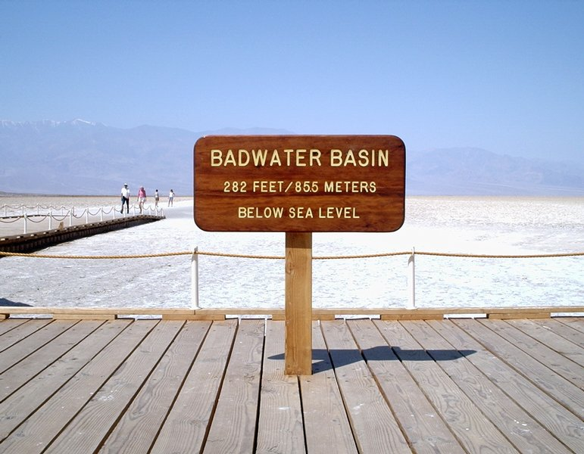
Notes:
… the actual marker is at the edge of the saltpan …

Slide 18
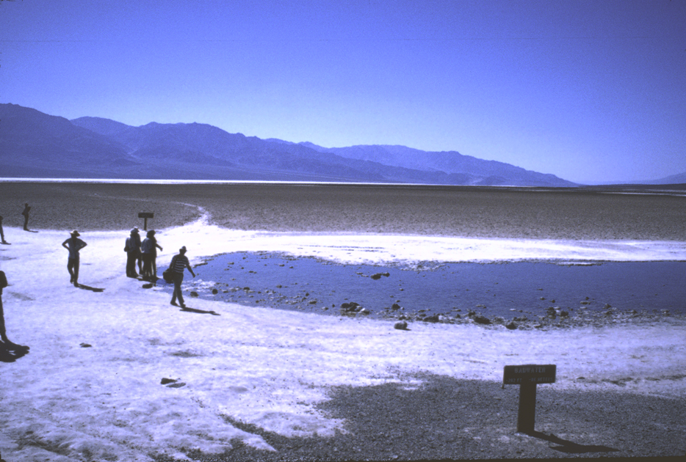
Notes:
… near a small, spring-fed pool. The extremely high salt content here gives Badwater its name.

Slide 19
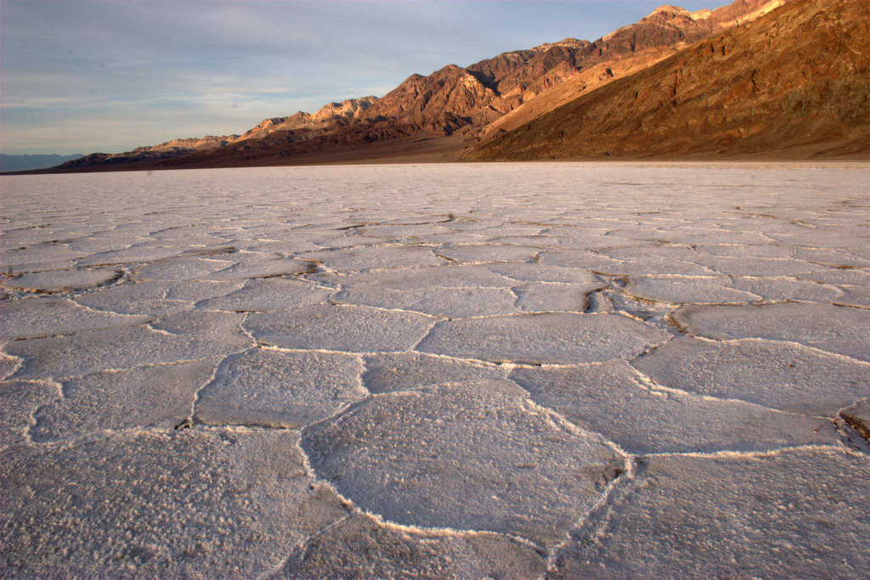
Salt Polygons
Notes:
Towards the center of the basin the salt crust covers fine mud deposits. Repeated wet-dry and freeze-thaw cycles have cracked and shaped the underlying mud into large polygonal shapes.

Slide 20
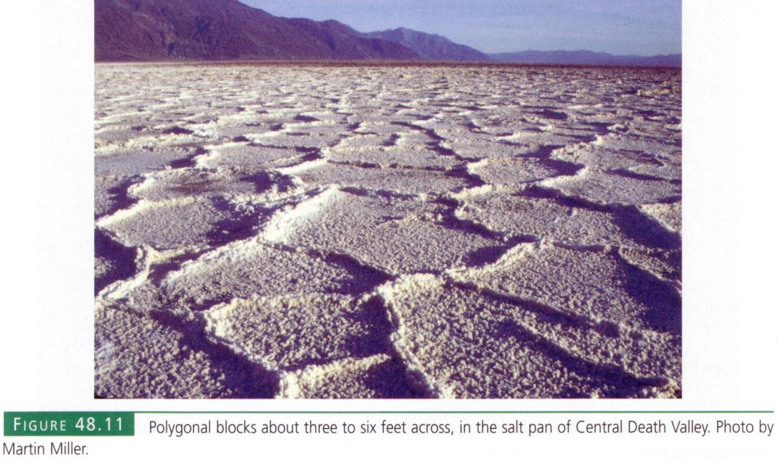
Notes:
Salt ridges surround the polygons due to the compressional buckling induced by the collective growth of salt crystals. Ridge growth is enhanced by capillary action, which draws salty brine from the underlying mud cracks towards the surface where it evaporates. The evaporation rate in Death Valley is the nation’s highest at 150 inches per year, which means that even a 12 foot deep lake would not last until the next season.

Slide 21
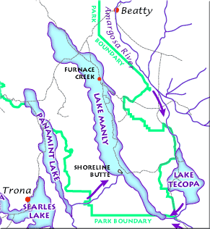
Lake Manly and other pluvial lakes - 22,000 years ago
Notes:
But that was not always the case. The cooler and wetter climate of the glacial ages allowed for a vast perennial lake to form in Death Valley called Lake Manly. Several other so called “pluvial”, or climate-maintained lakes formed throughout the Basin and Range during the glacial ages. Here we see the Lake Manly lake system as it might have looked during its last maximum extent 22,000 years ago.

Slide 22
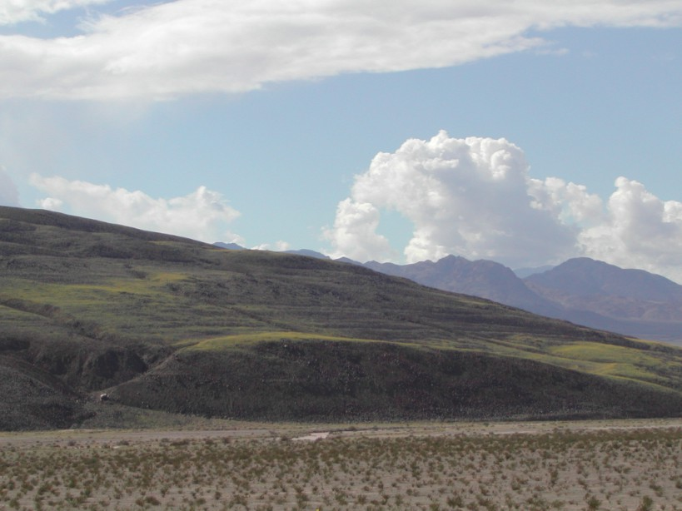
Shoreline Butte
Notes:
Shoreline Butte is one of many places in Death Valley where you can still see the relict shorelines formed by wave action around the ancient lake.

Slide 23
Notes:
Mormon Point is another. In both places wave-cut benches could form because the rocks there are relatively soft and erodible.

Slide 24
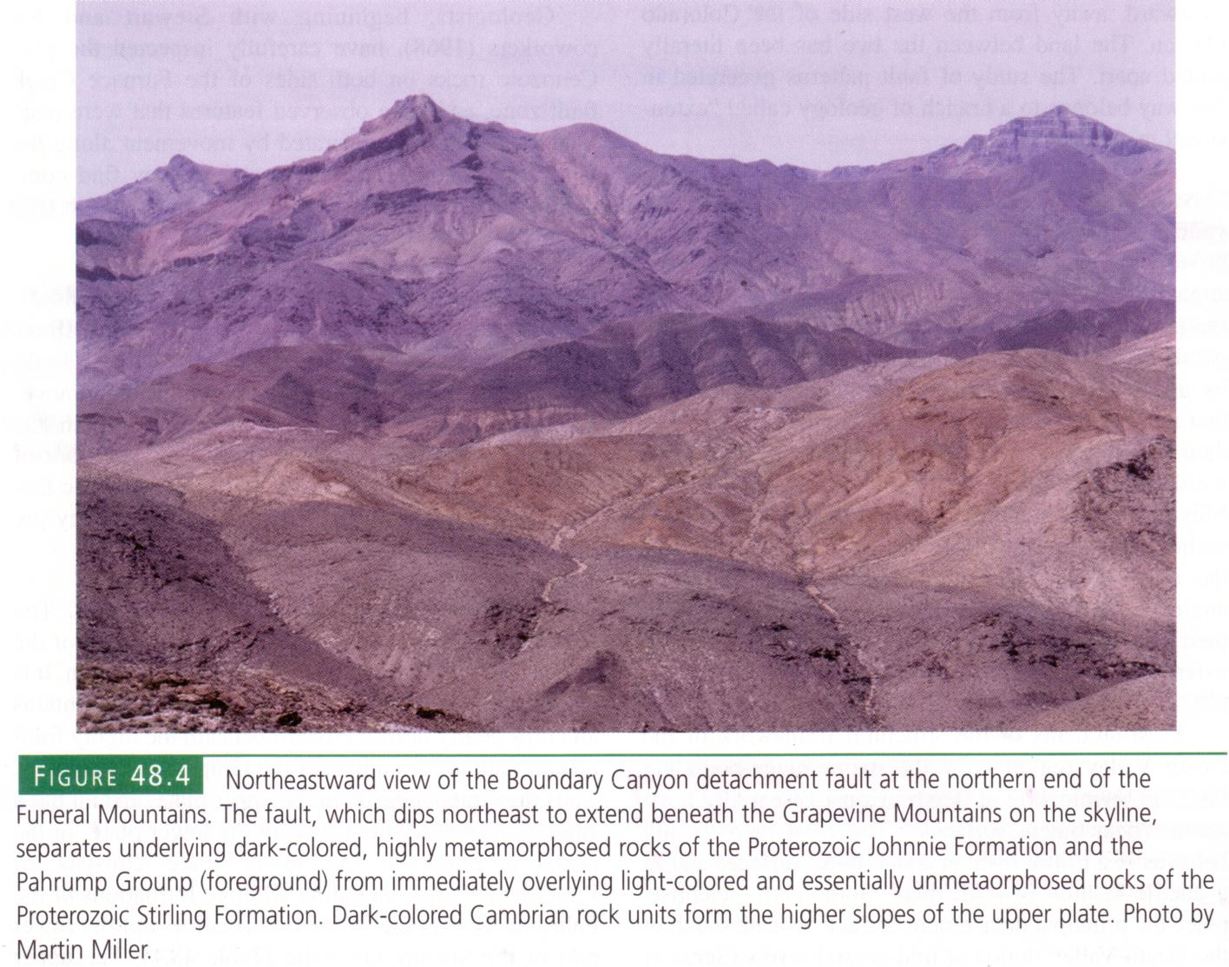
Detachment fault
Notes:
The tectonic extension which created Death Valley was, like many places in the Basin and Range, associated with detachment faulting and the emplacement of metamorphic core complexes. The Boundary Canyon detachment fault in the Funeral Mountains is particularly noticeable.

Slide 25
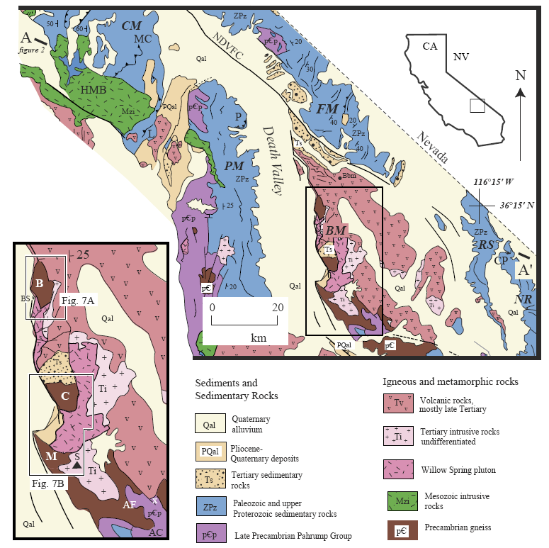
Funeral Mountains
Black Mountains
“TURTLEBACKS”
Badwater
Copper Canyon
Mormon Point
Notes:
But it is in the Black Mountains, south of the Funeral’s, that a full blown metamorphic core complex has been emplaced that is not unlike the one we studied in Saguaro National Park. Three prominent detachment corrugations, or “Turtlebacks” as they are known in Death Valley, are exposed here and aligned such that their long axis is parallel to the direction of extension. The Turtlebacks are comprised mostly of mylonite gneiss, which is the same kind of rock we saw in the Saguaro core complex.

Slide 26
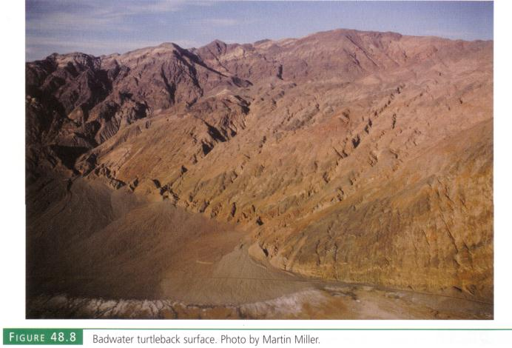
Notes:
The Badwater turtleback is the smallest, but least disturbed by erosion.

Slide 27
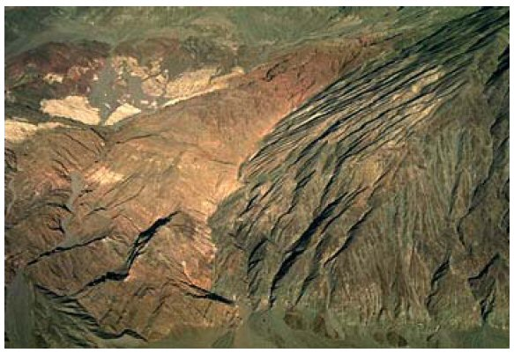
Notes:
From this view of the Copper Canyon turtleback, you can clearly see the contact with the lighter colored, upper plate sedimentary rocks.

Slide 28
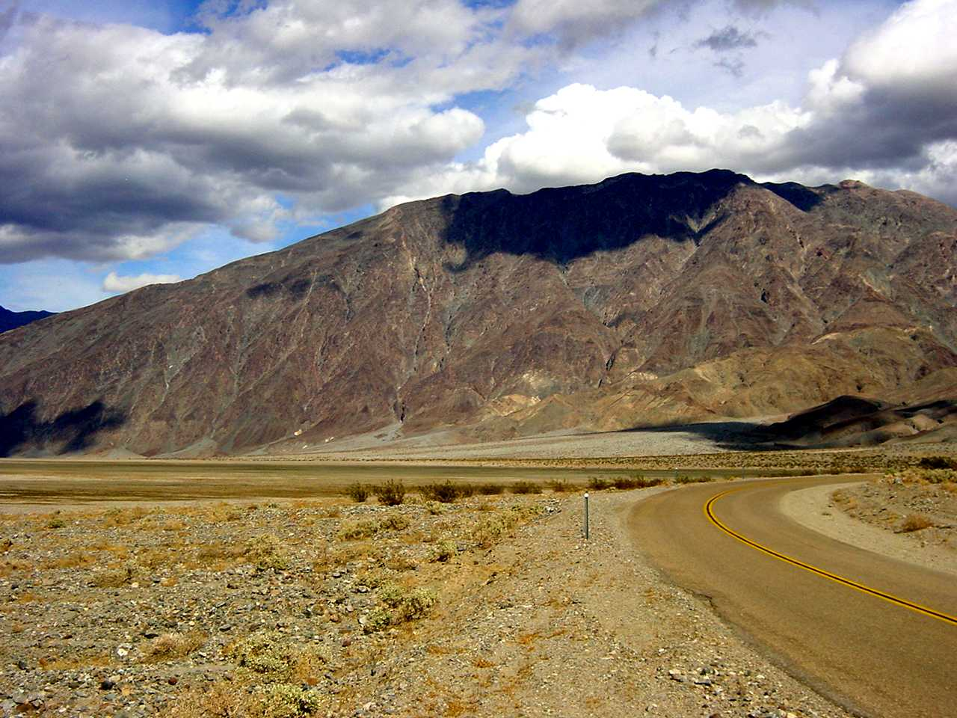
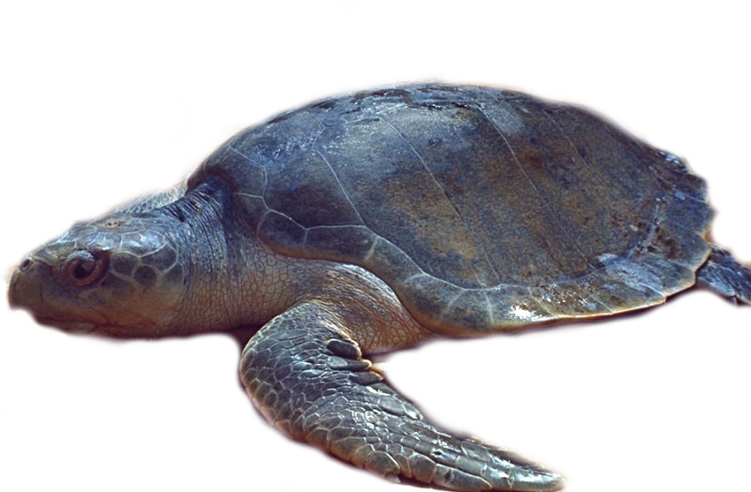
Notes:
Looking at the Copper Canyon turtleback from Mormon Point you can best see the double-plunging, antiformal shape from whence they get their name.

Slide 29
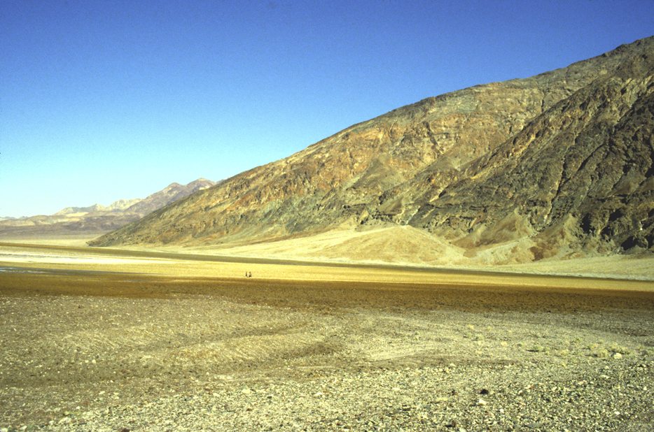
Notes:
The turtleback at Mormon Point is especially prominent.

Slide 30
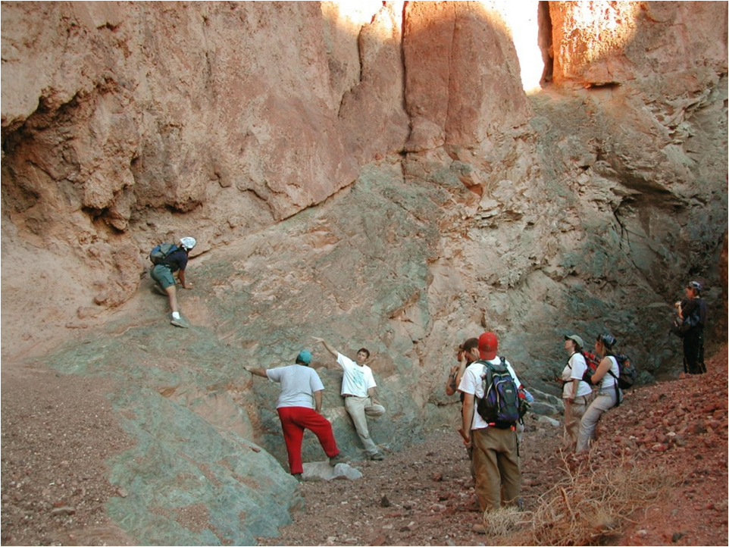
Notes:
Each turtleback is separated from upper plate rocks by normal faults whose relatively low angle is typical of detachment faulting.

Slide 31
Notes:
At the base of the turtleback faults…

Slide 32
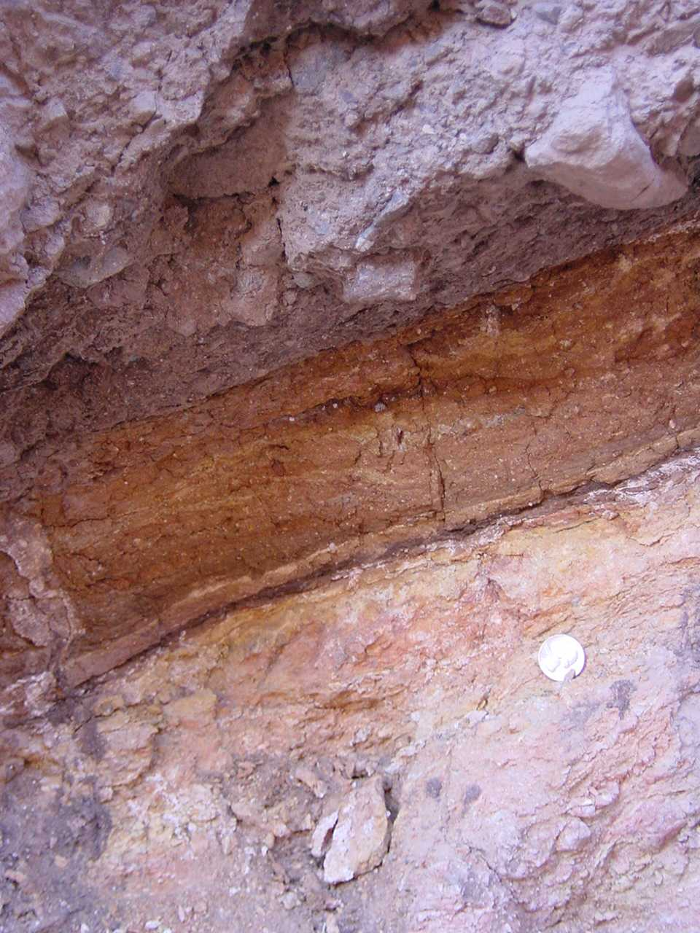
Fault gouge
Notes:
… there is fault gouge produced by the grinding and pulverization of rock as the upper plate rocks slid off the turtleback.

Slide 33
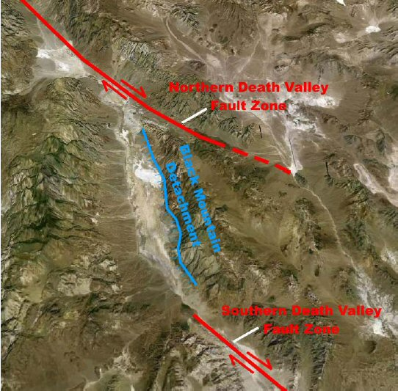
Notes:
So much extension and crustal thinning occurred in Death Valley that a very significant amount of decompression melting occurred in the underlying mantle, which resulted in widespread volcanic and plutonic activity.

Slide 34
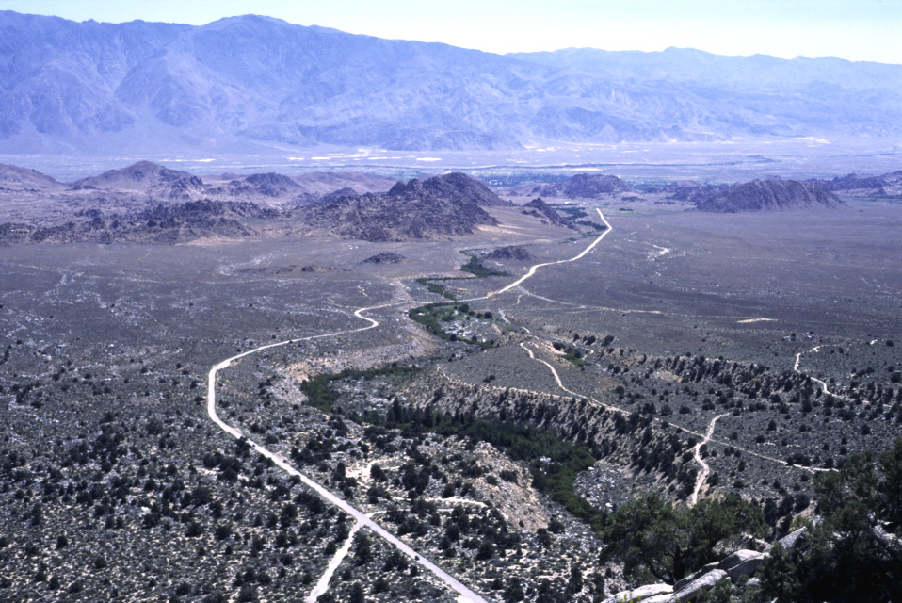
Miocene volcanic and plutonic field (foreground)
Notes:
The results of that magmatic activity are especially prevalent in the Central Death Valley volcanic and plutonic field in the foreground here, which is most visitors’ first encounter with the park as they enter from the south. Remember that decompression melting under continental crust results in bimodal magmatism. The basaltic magma that is initially produced is hot enough to cause partial melting of the continental crust, which results in more silica-rich rocks like the rhyolite, andesite and granite here.

Slide 35
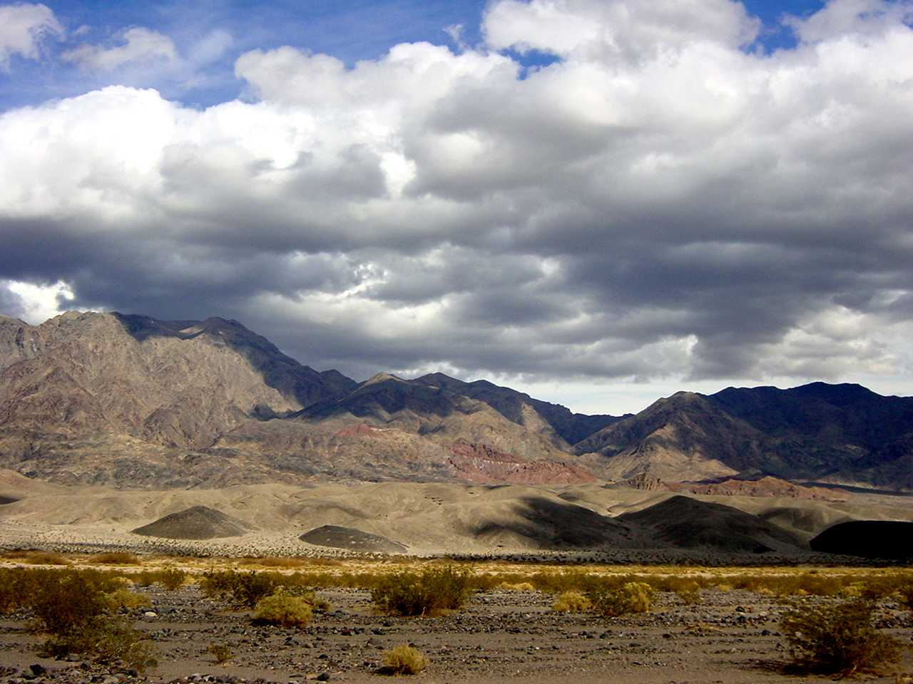
Basaltic cinder cones along fault trace
Notes:
Where there are faults, the basaltic magma can get to the surface quickly, so little partial melting occurs. Cinder cones typically form in these situations because the magma comes in contact with ground water, which becomes expanding steam that hurls the basaltic magma into the air where it solidifies into cinders.

Slide 36
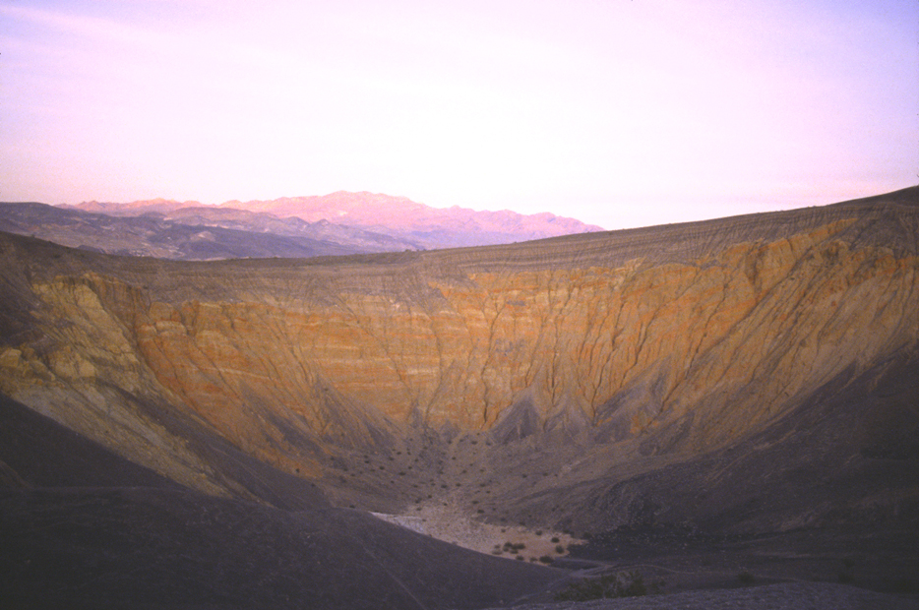
Ubehebe Crater
Notes:
At Ubehebe Crater near the park’s northern boundary, the interaction between basaltic magma and groundwater was especially violent. Quickly working its way along a major fault zone, the searing basaltic magma came in contact with water saturated bedrock and alluvial fan sediments. In an instant, water flashed to steam, and a violent release of steam-powered energy blasted away the confining rock above.

Slide 37
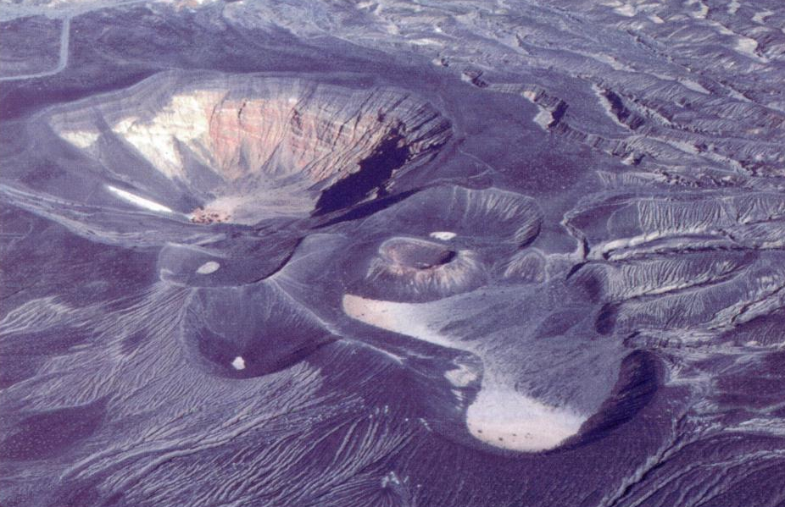
Cinder-strewn landscape around Ubehebe Crater
Notes:
The explosion produced a dense, ground-hugging cloud of rocky debris which surged out from the base at up to 100 miles/hour, decimating the landscape, and giving every living thing in the area a case of the ubehebegebes.

Slide 38
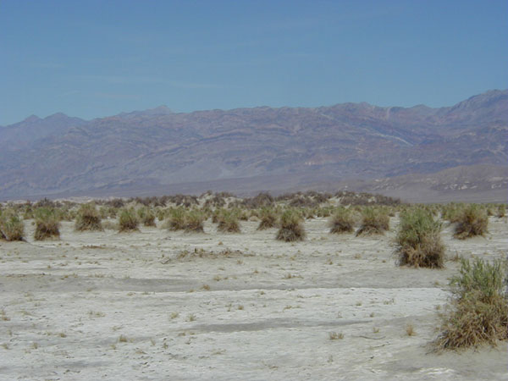
Devil’s Cornfield
Notes:
We have seen that most of the geologic features in Death Valley can be linked to extensional tectonics. This is even true of wind-produced features, like The Devils Cornfield, because the extension oriented the valley such that strong winds would focus there and deepened the valley to the point that it receives the least rainfall in the nation. Dry, bare soils are highly prone to wind erosion. The 'cornfield' formed because continual gusting winds blew away much of the fine sediment on the valley floor except for that anchored by vegetation.

Slide 39
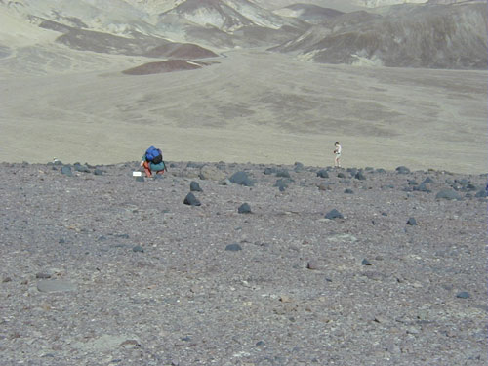
Ventifact Ridge
Notes:
Coarse particles will not be removed by the strong winds, but they may get sandblasted into ventifacts.

Slide 40
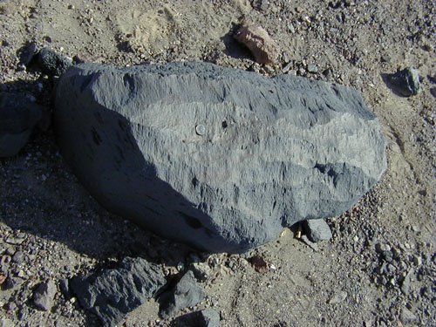
Large ventifact
Notes:
Ventifact surfaces are smoothed by abrasion caused when sand grains are blown against the rock surface, similar to sand-blasting. If you assume that this boulder hasn't been moved around, you can get an idea of how variable the wind direction is.

Slide 41
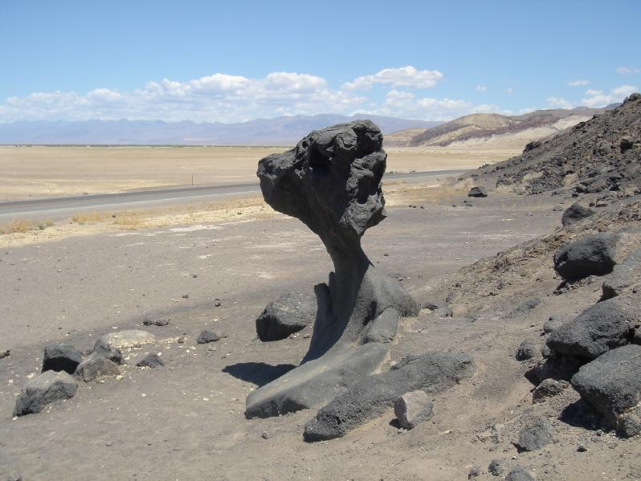
Mushroom Rock
Notes:
Like ventifacts, the formation of Mushroom Rock has been attributed to wind abrasion. However, another theory holds that corrosion by salty groundwater did the deed when the rock was buried.

Slide 42
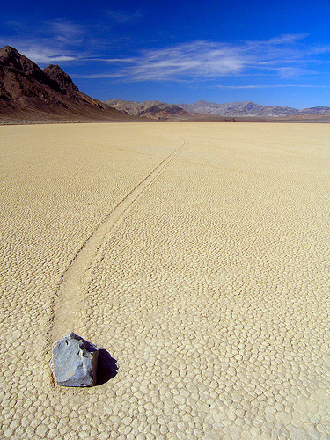
Racetrack Playa
Notes:
Wind is also at the root of most theories regarding the movement of stones across Racetrack Playa, but ice and slippery mud may play a role. Because no theory has yet to be universally accepted and nobody has been there to witness the event actually happen, there are even some nut jobs who believe the rocks are spirit processed and move on their own volition.

Slide 43
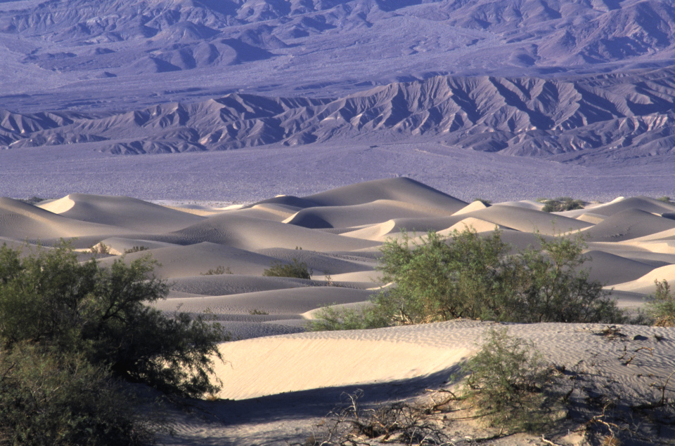
Notes:
At any rate, one place where the work of wind is completely undisputed is the Mesquite dune field near Stovepipe Wells.

Slide 44
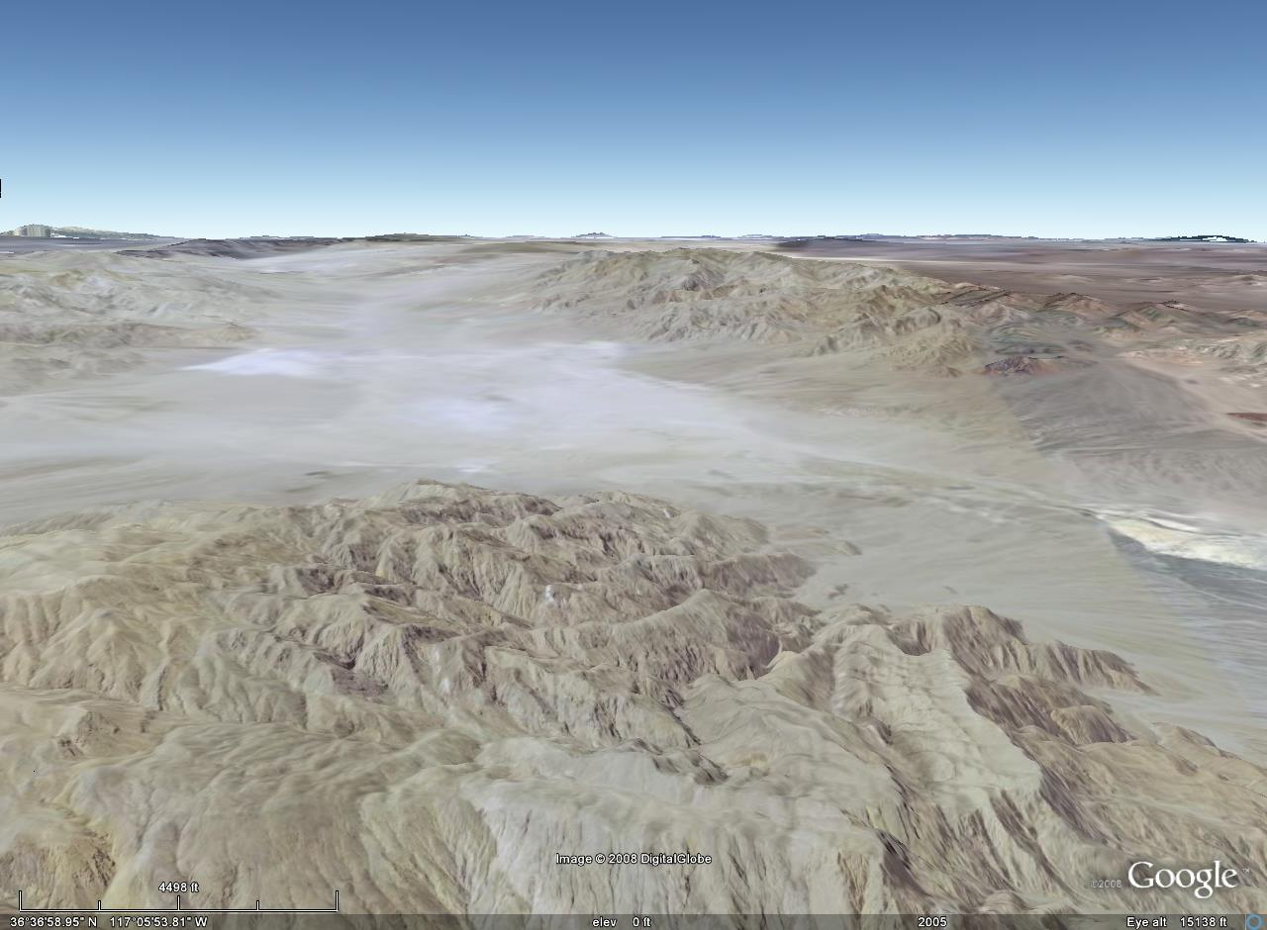
Prevailing winds
Dunes
Tucki Mountain
Notes:
Dunes formed there because the prevailing northwesterly winds slow down as they encounter the Tucki Mountains.

Slide 45
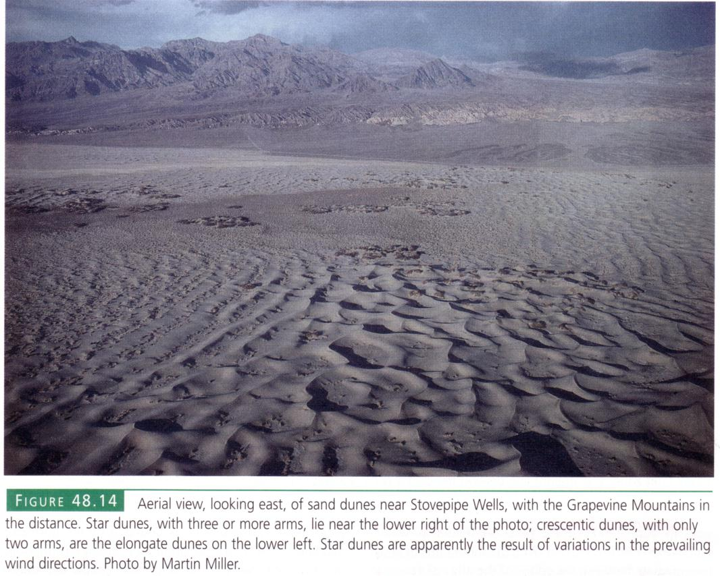
Longitudinal dunes
Star dunes
Notes:
Longitudinal dunes form where the wind direction is fairly constant. Star dunes, with typically three or more arms radiating from a central point, form where the winds are more variable.

Slide 46
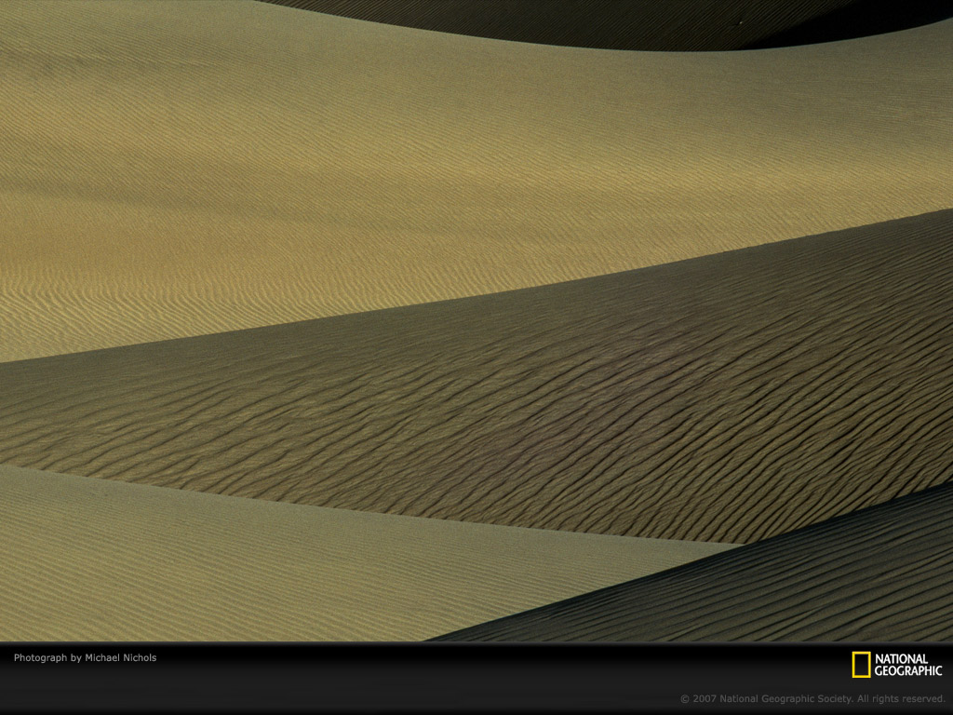
Notes:
The Mesquite Dunes are reputedly the most photographed in the world.

Slide 47
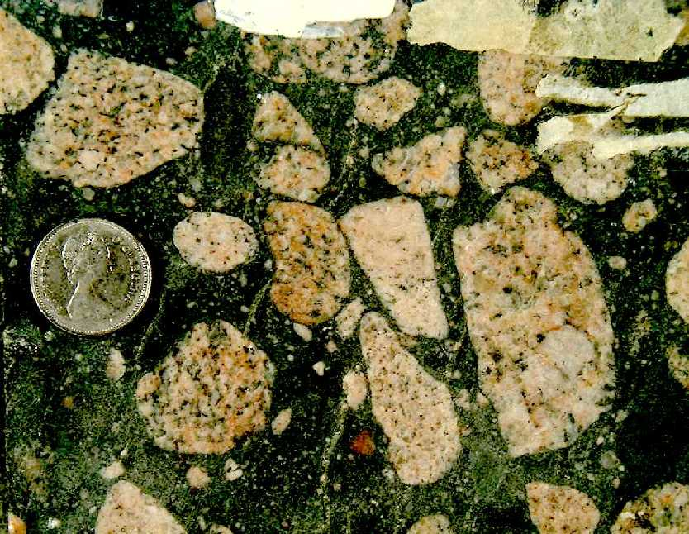
Notes:
Diamictite is interpreted as glacial till

Slide 48
Notes:
DV fault map

Slide 49
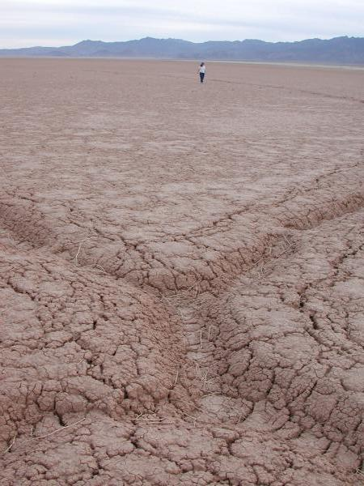
Notes:
giant desiccation polygon

Slide 50
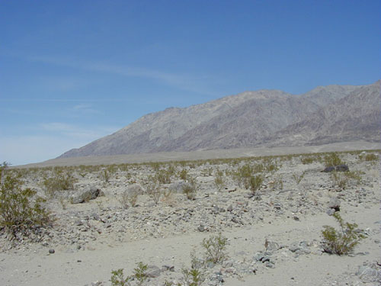
Notes:
Black Mountain turtleback: The east side of Death Valley is shaped by the large "turtlebacks," revealing metamorphic core complexes of the Black Mountains. The turtlebacks are fault-bounded, and represent the plane along which the Black Mountains have risen from deep beneath the Earth‘s crust.

Slide 51
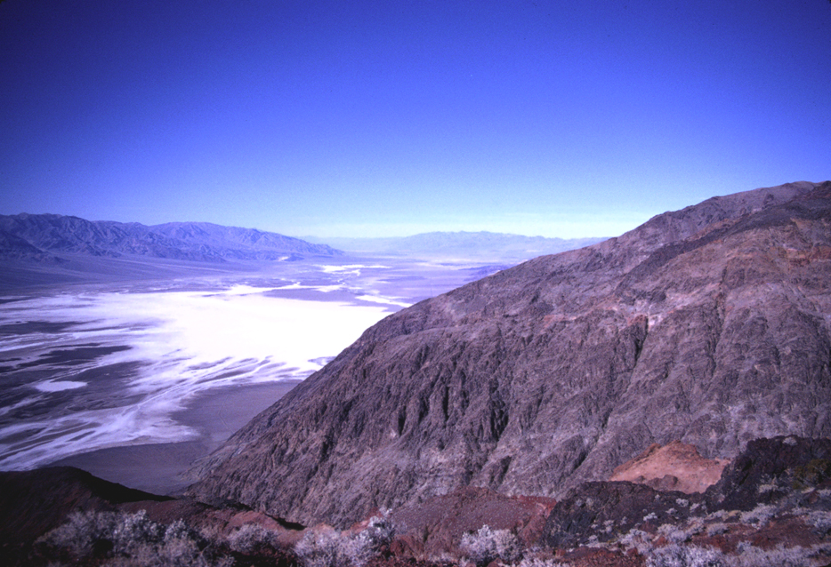
Notes:
Death Valley 8 DKH.jpg (Photo by Daniel K. Holm)

Slide 52
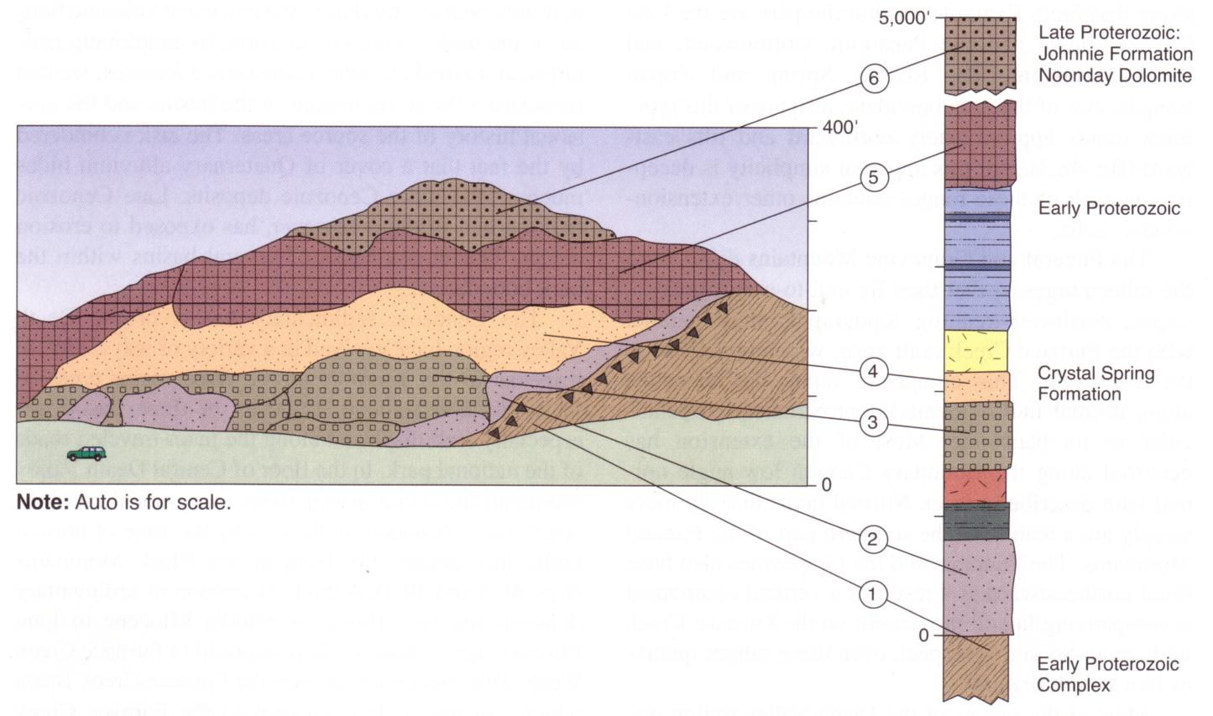
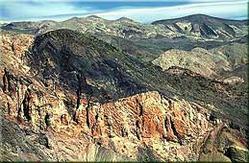
The Amargosa Chaos
Units stacked and thinned by low angle normal faulting
Notes:
The Amargosa chaos

Slide 53
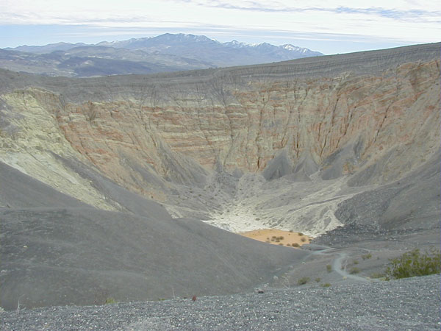
Notes:
Ubehebe crater

Slide 54
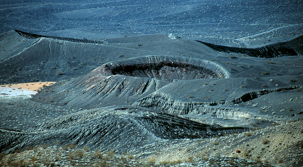
Notes:
Little hebe

Slide 55
Notes:
Dunes form here because the conflue

